Slide 1
Topic: Geometry and Mapping EQ: How can we use map scales to figure out real life distances?
Year 11 Mathematics Essentials

Slide 2
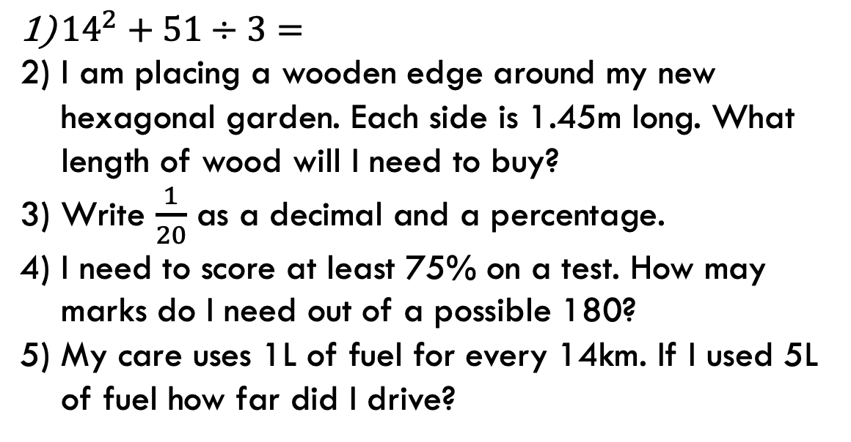
Five Questions
Topic: Geometry and Mapping
EQ – How can we apply our knowledge of scale ratios to figure out real life distances?
Answers
1) 213
2) 8.7m
3) 0.05, 5%
4) 135 marks
5) 70km
${14}^{2}+51÷3=$
I am placing a wooden edge around my new hexagonal garden. Each side is 1.45m long. What length of wood will I need to buy?
Write $\frac{1}{20}$ as a decimal and a percentage.
I need to score at least 75% on a test. How may marks do I need out of a possible 180?
My care uses 1L of fuel for every 14km. If I used 5L of fuel how far did I drive?

Slide 3
24
7
30
Date: XX/XX/2021
Topic: Geometry and Mapping
EQ – How can we apply our knowledge of scale ratios to figure out real life distances?
TASK: Computers
1. Explore: Different maps use different scales, depending on the amount of detail they want to show.
Explore this concept by typing the location “Perth WA” into an online mapping program and follow and answer the 5 questions.
2. Apply: Use the map to answer the questions 6 – 8 in the book.
3. Extension: You need to examine public transport options for getting to Perth Zoo. Starting from Mary Davies Library. Use the online mapping site you have found or Transperth to look to see what public transport options you have in those locations and calculate the distances involved.
WICOR

Slide 4
24
7
30
Date: XX/XX/2021
Topic: Geometry and Mapping
EQ – How can we apply our knowledge of scale ratios to figure out real life distances?
4. Investigate: You need to arrive at Perth Zoo by 9:00am on a weekday. Use this information, combined with the software to find some options for both car and public transport.
Record several of the routes suggested by the software. Make sure you include a copy of the route, the times for each journey and the distances travelled so that you have a variety of options to consider. 5. Evaluate:
How does the time for each journey change if you are happy to arrive at 8:30am?
How about if you want to arrive at 8:00am?
Why do you think the time varies?
TASK: Computers
WICOR

Slide 5
Kahoot!
https://create.kahoot.it/details/map-work-and-scale-and-compass-directions/dab6010a-938d-401b-b205-776863746592

